Slide 1
Mongo DB– Step 10

Slide 2
No SQL Database
In SQL database we store the data in table format.
In SQL we use column and row concept which help to store homogenous data
In SQL before storing we have to define the schema and then we have to store
But we if want to store heterogeneous and schema less databases are
No SQL Databases present in market are
Key-value -→ redis
Graph database → Neo4j
Document oriented -→ Mongo DB
Column family → Cassandra and HBase

Slide 3
Mongo DB
MongoDB is an open source NoSQL database management program.
NoSQL (Not only SQL) is used as an alternative to traditional relational databases.
NoSQL databases are quite useful for working with large sets of distributed data.
MongoDB is a tool that can manage document-oriented information, store or retrieve information.
In Mongo db database we store the data in json format using document.

Slide 4
RDBMS Vs Non SQL database (Mongo DB)
RDMBS Mongo DB
Database database
Table collections
Records documents.
In table format in json format.

Slide 5
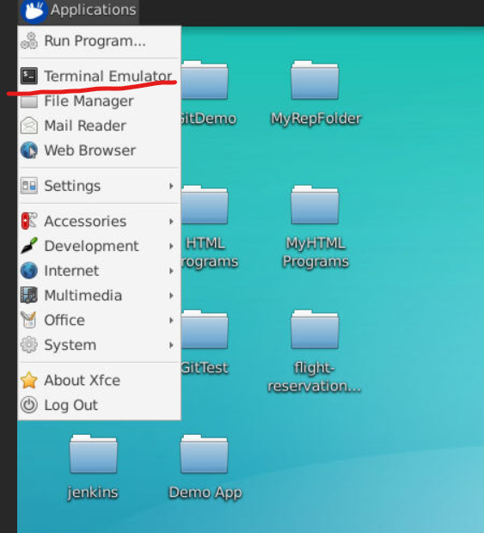
Connect to virtual lab with your login details
Open the terminal in virtual lab.

Slide 6
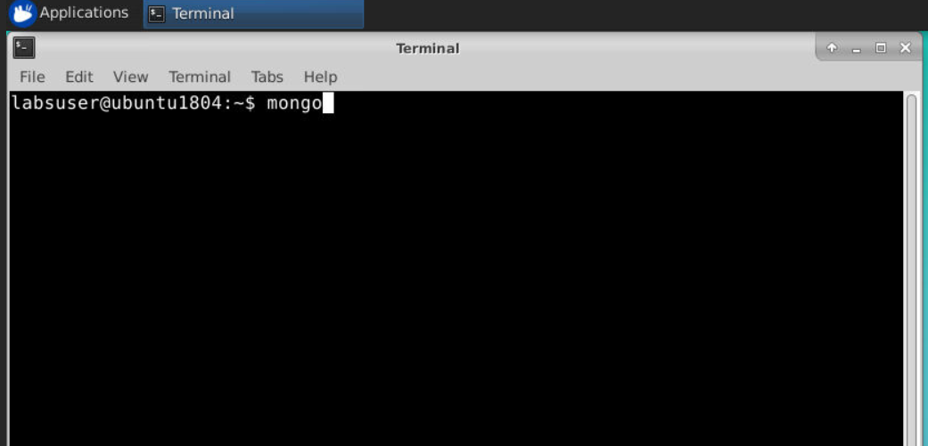
Write mongo command

Slide 7
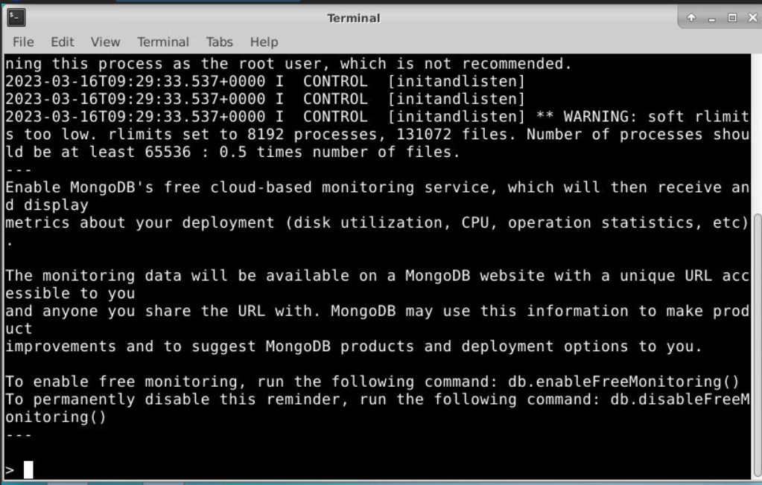
If mongo present then it will open mongo terminal

Slide 8
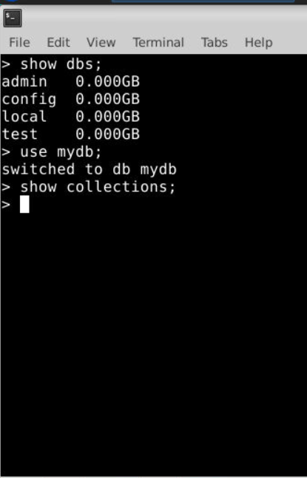
To clear the screen we have to write cls
To see all database
show dbs
To move or create new db
use dbname
To view all collection
Show collections

Slide 9
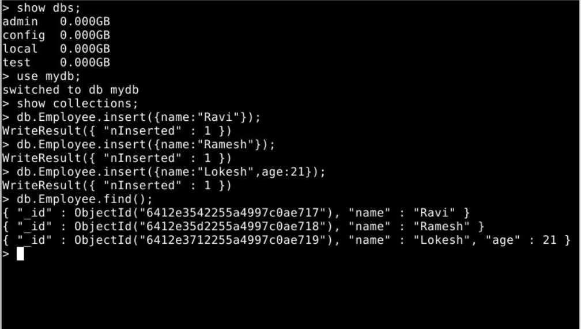
To create collection and store documents.
Insert document in Employee collection
db.CollectionName.insert({key:value})
db.Employee.insert({name:”Ravi”})
view documents from Employee collection
db.CollectionName.find();
db.Employee.find();

Slide 10
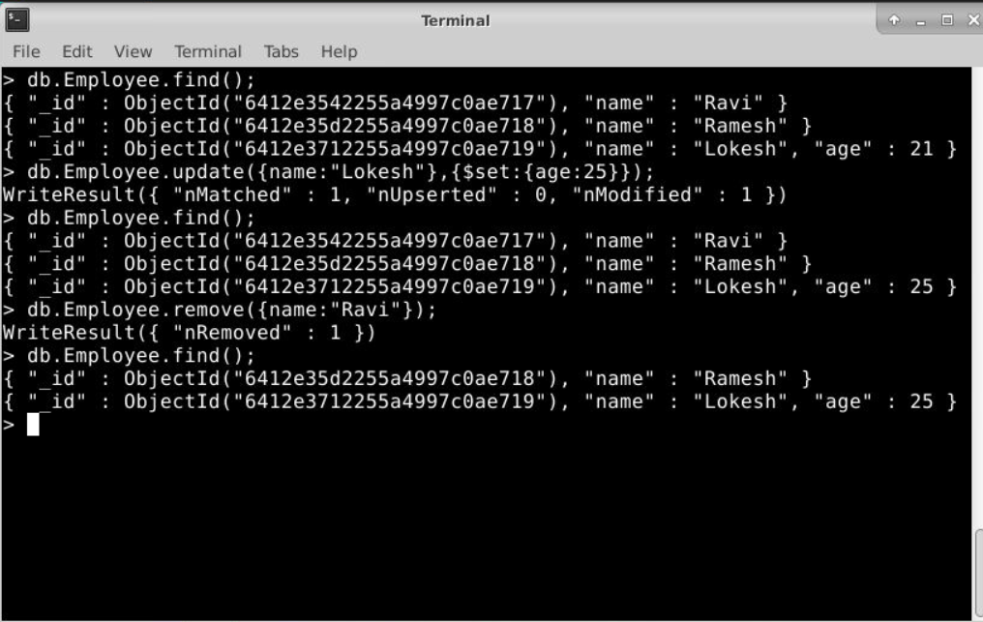
Update and delete documents from collection
Update document field value in mongo db
db.collectionName.update({key:value},{$set:{key:value})
db.Employee.update({name:”Lokesh”},{$set:{age:24}})
Remove document field value in mogno db
db.collectionName.remove({key:value})
db.Employee.remove({name:”Ravi”})

